Slide 1
Ethics in Computer Security and Privacy
Security, Privacy, and Consumer Protection Nick Feamster University of Chicago

Slide 2
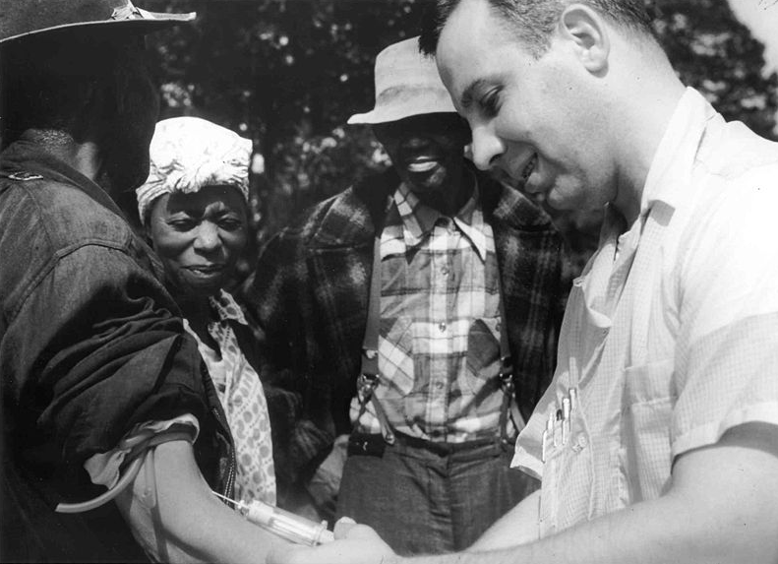
Notes:
English: Doctor injecting a patient with placebo as part of the Tuskegee Syphilis Study
The Tuskegee Study of Untreated Syphilis in the Negro Male, also known as the Tuskegee Syphilis Study or Tuskegee Syphilis Experiment (/tʌsˈkiːɡiː/ tus-kee-ghee)^{[1]} was an infamous clinical study conducted between 1932 and 1972 by the U.S. Public Health Service studying the natural progression of untreated syphilis in rural African-American men in Alabama under the guise of receiving free health care from the United States government.^{[1]}
The Public Health Service started working on this study in 1932 during the Herbert Hooveradministration, in collaboration with Tuskegee University, a historically black college in Alabama. Investigators enrolled in the study a total of 600 impoverished, African American sharecroppers fromMacon County, Alabama. Of these men, 399 had previously contracted syphilis before the study began, and 201^{[2]} did not have the disease. The men were given free medical care, meals, and free burial insurance for participating in the study. After funding for treatment was lost, the study was continued without informing the men they would never be treated. None of the men infected were ever told they had the disease, and none were treated with penicillin even after the antibiotic became proven for the treatment of syphilis. According to the Centers for Disease Control, the men were told they were being treated for "bad blood", a local term for various illnesses that include syphilis, anemia, and fatigue.
The 40-year study was controversial for reasons related to ethical standards because researchers knowingly failed to treat patients appropriately after the 1940s validation of penicillin as an effective cure for the disease they were studying. Revelation in 1972 of study failures by a whistleblower led to major changes in U.S. law and regulation on the protection of participants in clinical studies. Now studies require informed consent,^{[3]} communication of diagnosis, and accurate reporting of test results.
Tuskegee highlighted issues in race and science.^{[41]} The aftershocks of this study, and other human experiments in the United States, led to the establishment of the National Commission for the Protection of Human Subjects of Biomedical and Behavioral Research and the National Research Act. The latter requires the establishment of institutional review boards (IRBs) at institutions receiving federal support (such as grants, cooperative agreements, or contracts). Foreign consent procedures can be substituted which offer similar protections and must be submitted to the Federal Register unless a statute or Executive Order requires otherwise.
One researcher critiqued how the study was administered and its change in purpose. He said that it was "the economic exploitation of humans as a natural resource of a disease that could not be cultivated or animals in order to establish and sustain U.S. superiority in patented commercial biotechnology."^{[43]}
Due to the lack of information, the participants were manipulated into continuing the study without full knowledge of their role or their choices.^{[44]} Since the late 20th century, IRBs established in association with clinical studies require that all involved in study be willing and voluntary participants.^{[45][46]}

Slide 3
Why are we talking about this? (in Lecture 2?)

Slide 4


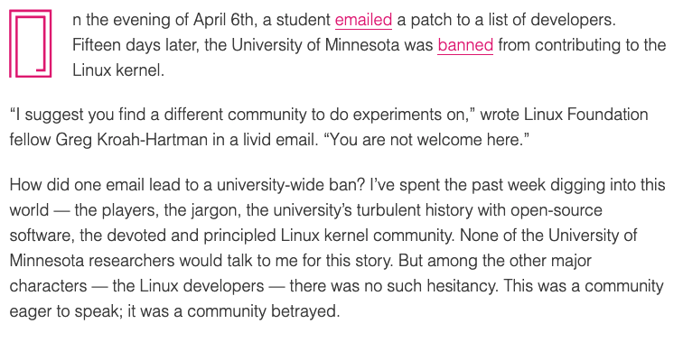

Slide 5
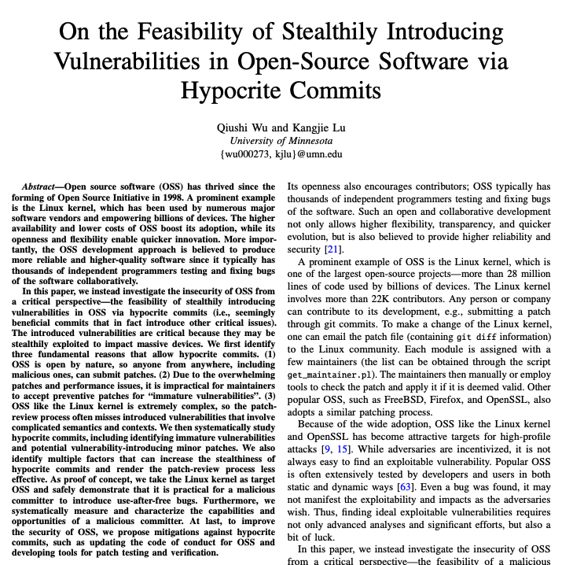
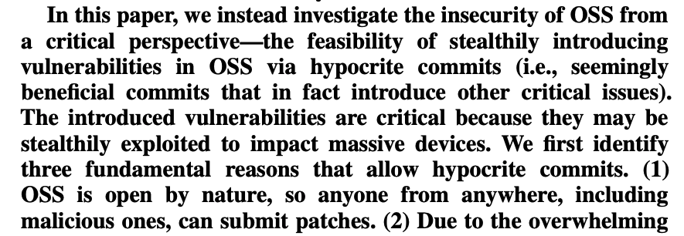
“Hypocrite Commit” Experiment (February 2021)

Slide 6
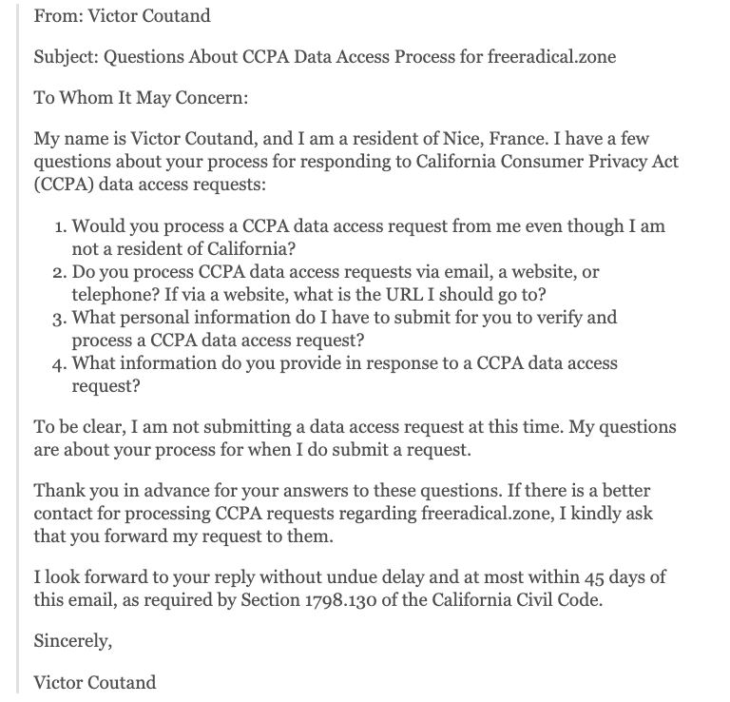
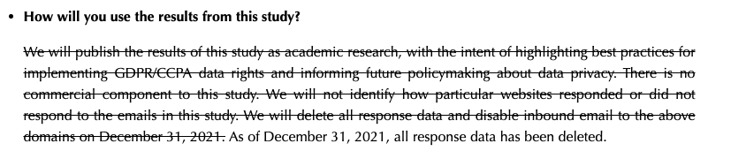
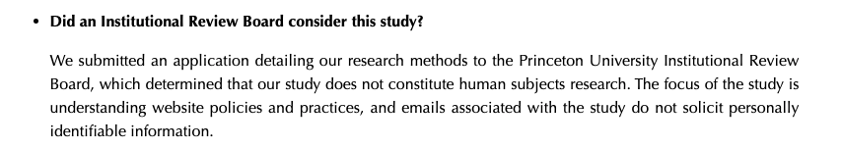
GDPR / CCPA Email “Scam” (November 2021)

Slide 7
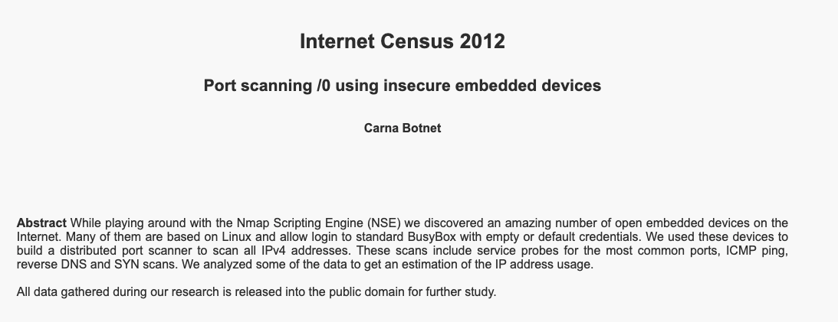
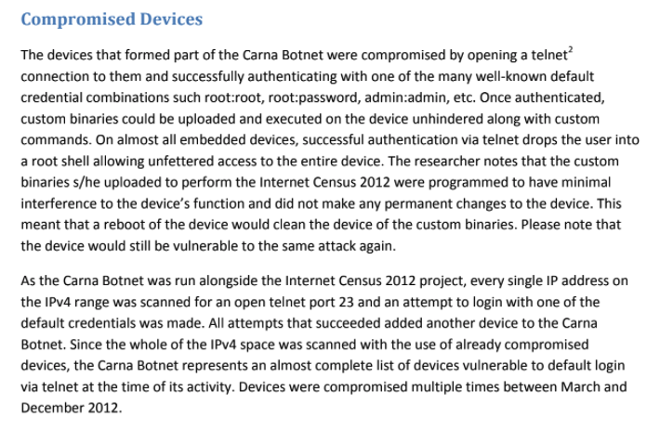
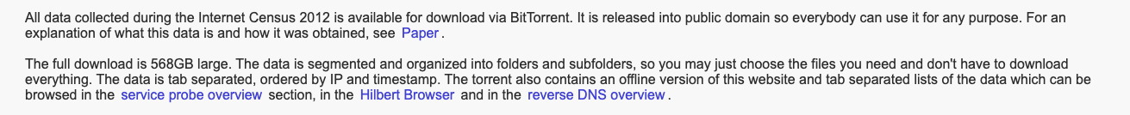
Carna Botnet (2012)

Slide 8
Agenda for Today
A few recent examples… (beyond the reading)
Principles and practice of ethics
Breakout discussions:
Carna botnet
Privacy regulation compliance
Open-source security

Slide 9
What is “Ethics”?
“Ethics (or moral philosophy) involves systematizing, defending, and recommending concepts of right and wrong behavior.”
Normative ethics, is concerned with developing a set of morals or guiding principles intended to influence the conduct of individuals and groups within a population (i.e., a profession, a religion, or society at large).
Consequentialism
Deontology

Slide 10
Computer Ethics
“A typical problem in computer ethics arises because there is a policy vacuum about how computer technology should be used.
Computers provide us with new capabilities and these in turn give us new choices for action. Often, either no policies for conduct in these situations exist or existing policies seem inadequate.
A central task of computer ethics is to determine what we should do in such cases, i.e., to formulate policies to guide our actions.”
-Moor

Slide 11
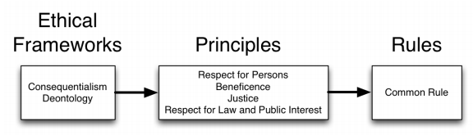
Salganik’s Principles-Based Approach

Slide 12
Key Idea: Digital is Different
“Social research in the digital age has different characteristics and therefore raises different ethical questions.”
Capabilities are changing faster than rules, laws, and norms.
Increasing power is not matched by increased clarity in how that power should be used.

Slide 13
Surveillance: Digital Panopticon or “Database of Ruin”?
“Researchers have the ability of observe and perturb people without their consent or awareness.”
Trends: ubiquitous sensing, dropping cost of storage…
Prospects of a master database
Chilling effects
Secondary uses

Slide 14


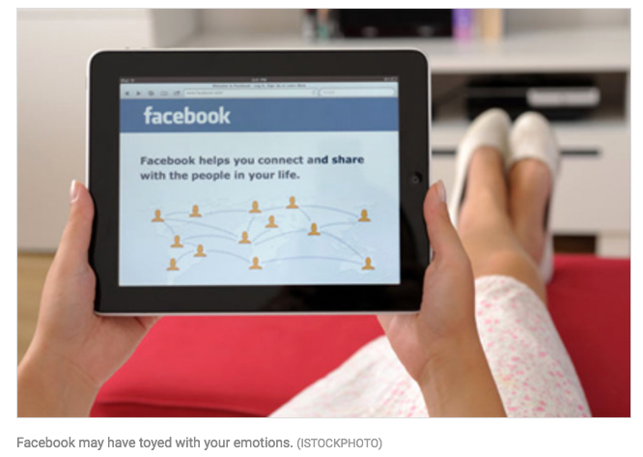
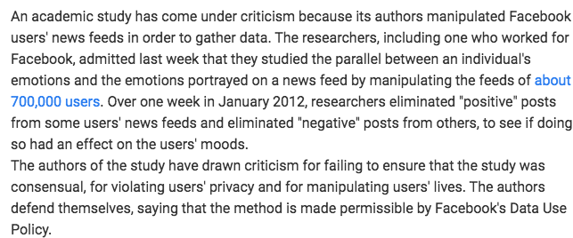
Case Study: Emotional Contagion

Slide 15
Emotional Contagion: Summary
January 2012, 700,000 Facebook users
Altering posts that users saw in news feeds based on negative positive words
Evidence for “emotional contagion”

Slide 16
Emotional Contagion: Reasons for Concern
Users did not consent
Research did not undergo any ethical review

Slide 17
Other Case Studies
Taste, ties, and time
Deanonymization of social network data crawled from Facebook
Encore
Censorship measurements without user consent
Both studies underwent ethical review. Often not sufficient… Inconsistent and overlapping rules, laws, and norms.

Slide 18
Sources of Inconsistency
Outdated rules
Active debates around norms
Mixing of contexts

Slide 19
Salganik’s Principles-Based Approach
A main argument of this chapter is that researchers should evaluate their research through existing rules—which I will take as given and assume should be followed—and through more general ethical principles.

Slide 20
IRB, Belmont, Menlo
The primary goal of the Institutional Review Board (IRB) is to assure that, in research involving human subjects, the rights and welfare of the subjects are adequately protected.
"Ethical Principles and Guidelines for the Protection of Human Subjects of Research”, United States Department of Health, Education, and Welfare, April 18, 1979 (Belmont Report)
Respect for persons
Individuals should be treated autonomously
Informed consent should be freely given
Beneficence
Do no harm
Maximize possible benefits/minimize risks
Justice
Equitable selection of research subjects
Respect for Law and Public Interest

Slide 21
Common Rule
Federal policy regarding human subjects protection
Applies to 17 federal agencies.
Universities typically also follow.

Slide 22
Common Rule
Requirements for assuring compliance by research institutions
Requirements for researchers’ obtaining and documenting informed consent
Requirements for Institutional Review Board membership, function, operations, review, record keeping
http://ori.hhs.gov/education/products/ucla/chapter2/page04b.htm
Notes:
Also, protections for pregnant women, prisoners, and children…

Slide 23
Salganik’s Principles-Based Approach

Slide 24
Belmont Report
Respect for persons: protecting the autonomy of all people and treating them with courtesy and respect and allowing for informed consent. Researchers must be truthful and conduct no deception;
Beneficence: The philosophy of "Do no harm" while maximizing benefits for the research project and minimizing risks to the research subjects; and
Justice: ensuring reasonable, non-exploitative, and well-considered procedures are administered fairly — the fair distribution of costs and benefits topotential research participants — and equally.
https://en.wikipedia.org/wiki/Belmont_Report
Notes:
First, in 1974, in response to ethical failures by researchers, such as the notorious Tuskegee Syphilis Study (see Historical Appendix), the US Congress created a national commission to write ethical guidelines for research involving human subjects. After four years of meeting at the Belmont Conference Center, the group produced the Belmont Report, a slender but powerful document. The Belmont Report is the intellectual basis for the Common Rule, the set of regulations governing human subjects research that Institutional Review Boards (IRBs) are tasked with enforcing (Porter and Koski 2008)
The Belmont Report was first written by the National Commission for the Protection of Human Services of Biomedical and Behavioral Research.^{[5]} Prompted in part by problems arising from the Tuskegee Syphilis Study (1932–1972) and based on the National Commission for the Protection of Human Subjects of Biomedical and Behavioral Research (1974–1978), the Department of Health, Education and Welfare (HEW)^{[6]} revised and expanded its regulations for the protection of human subjects 45 CFR part 46 in the late 1970s and early 1980s. In 1978, the Commission’s report Ethical Principles and Guidelines for the Protection of Human Subjects of Research was released, and it was published in 1979 in the Federal Register. It was named the Belmont Report, for theBelmont Conference Center, where the National Commission met when first drafting the report.^{[7]}
The Belmont Report is one of the leading works concerning ethics and health care research. It allows for the protection of participants in clinical trials and research studies.^{[5]}

Slide 25
Respect for Persons
Treat people as autonomous, honor wishes
If possible, obtain informed consent (not always possible, as discussed in Salganik’s book!)
Violations can occur even in benign studies!
Notes:
Then, in 2010, in response to the ethical failures of computer security researchers and the difficulty of applying the ideas in the Belmont Report to digital age research, the US Government—specifically the Department of Homeland Security—created a blue-ribbon commission to write a guiding ethical framework for research involving information and 16 communication technologies (ICT). The results of this effort was the Menlo Report (Dittrich, Kenneally, and others 2011). Together the Belmont Report and the Menlo Report offer four principles that can guide ethical deliberations by researchers: Respect for Persons, Beneficence, Justice, and Respect for Law and Public Interest. Applying these four principles in practice is not always straightforward, and it can require difficult balancing. The principles, however, help clarify trade-offs, suggest changes to research designs, and enable researchers to explain their reasoning to each other and the general public.

Slide 26
Beneficence
Understand the risk/benefit profile (technical)
Does it strike the right balance? (ethical)
Not “Do no harm”(!)
Learning what is beneficial may involve exposing some people to risk!
Notes:
Ethical analysis may be enriched by people who do not have subject-matter expertise.
Might need to ask non-experts/non-research.
Open and reproducible research increases benefits, generally.

Slide 27
Justice
Fair distribution/equitable sharing of risks and benefits
One group in society should not bear the risks while another reaps the benefits.
Notes:
For example, in the 19th and early 20th century, the burdens of serving as research subjects in medical trials fell largely on the poor, and the benefits of improved medical care flowed primarily to the rich

Slide 28
Areas of Difficulty
Informed consent
Increasing risk, compromising research goals, logistical limitations
Informational risk
Harm from disclosure of information
Privacy
Right to appropriate flow of information
Contextual integrity: focus on flows of information
Notes:
Ask for examples of each of the difficulties of informed consent…
“Some form of consent for most things.”
Sweeney study. Netflix: All data is potentially identifiable and sensitive. Difficult to estimate risk from disclosure.
Data disclosure may increase risk to participants
Talk about examples of contextual integrity

Slide 29
Salganik’s Principles-Based Approach

Slide 30
Ethical Frameworks
Consequentialism (ends)
“The ends justify the means.”
Deontology (means)
Focus on ethical duties, regardless of consequences.
Notes:
Consequentialism, which has roots in the work of Jeremy Bentham and John Stuart Mill, focuses on taking actions that lead to better states in the world (Sinnott-Armstrong 2014). The principle of Beneficence, which focuses on balancing risk and benefits, is deeply rooted in consequentialist thinking.
On the other hand, deontology, which has roots in the work of Immanuel Kant, focuses on ethical duties, independent of their consequences 24 (Alexander and Moore 2015). The principle of Respect for Persons, which focuses on the autonomy of participants, is deeply rooted in deontological thinking.
Given these approaches, a pure consequentialist might be willing to waive the requirement for informed consent in a setting where there was no risk, whereas a pure deontologist might not.
(example of terrorist with timebomb)

Slide 31
Concepts
Minimal risk
Power analysis
Ethical response surveys
Notes:
Note: Precautionary principle can actually be harmful!

Slide 32
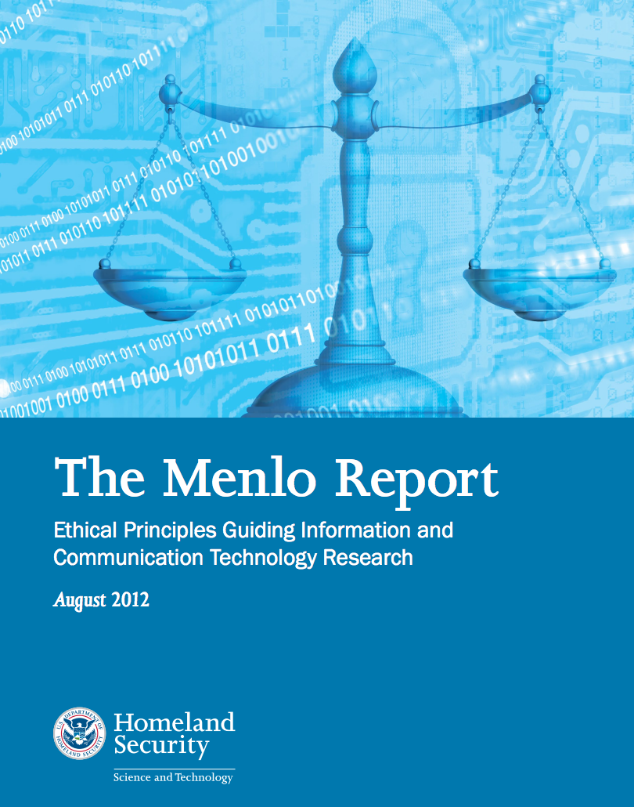
Respect for Law and Public Interest
Expands Beneficence to include all relevant stakeholders.
Compliance
Transparency-based accountability
Notes:
Compliance means that researchers attempt to identify and obey relevant laws, contracts, and terms of service. For example, compliance would mean that a researcher considering scraping the content of a website should read and consider the terms-of-service agreement of that website. There may, however, be situations where it is permissible to violate the terms of service. For example, at one 22 time both Verizon and AT&T had terms of service that prevented customers from criticizing them (Vaccaro et al. 2015).
Researchers should not be automatically bound by such termsof-service agreements. Ideally, if researchers violate terms of service agreements, they should explain their decision openly (e.g., Soeller et al. (2016)). But, this openness may expose researchers to added legal risk. In the United States, for example, the Computer Fraud and Abuse Act makes it illegal to violate terms of service agreements (Sandvig and Karahalios 2016).
transparency-based accountability means that researchers need to be clear about the goals, methods, and results at all stages of their research process and to take responsibility for their actions. Another way to think about this transparency-based accountability is that it is trying to prevent the research community from doing things in secret. This transparency-based accountability enables a broader role for the research community and the public in ethical debates, which is important for both ethical and practical reasons.

Slide 33
Ethics != Law
“Law can be defined as a consistent set of universal rules that are widely published, generally accepted, and usually enforced”
Related but by no means identical (e.g., legal but not ethical, ethical but not legal)
Adherence to ethical principles may be required to meet regulatory requirements surrounding academic research
A law may illuminate the line between beneficial acts and harmful ones.
If the computer security research community develops ethical principals and standards that are acceptable to the profession and integrates those as standard practice, it makes it easier for legislatures and courts to effectively perform their functions.

Slide 34
Laws to Know About
Computer Fraud and Abuse Act (CFAA)
"it is illegal to intentionally access a computer without authorization or in excess of authorization and thereby obtaining information from any protecting computer."
Digital Millennium Copyright Act (DMCA)
“No person shall circumvent a technological measure that effectively controls access to [a work protected by copyright law]”
Electronic Communications Privacy Act (ECPA)
Wiretap Act
Pen Register Statute
Stored Communications Act
State and Local Laws
Computers and networks may carry data for a variety of institutions such as hospitals, libraries, universities, and K-12 organizations
Family Educational Right to Privacy Act (FERPA)
Federal Standards for Privacy of Individually Identifiable Health Information (implements the privacy requirements HIPAA)

Slide 35


Slide 36
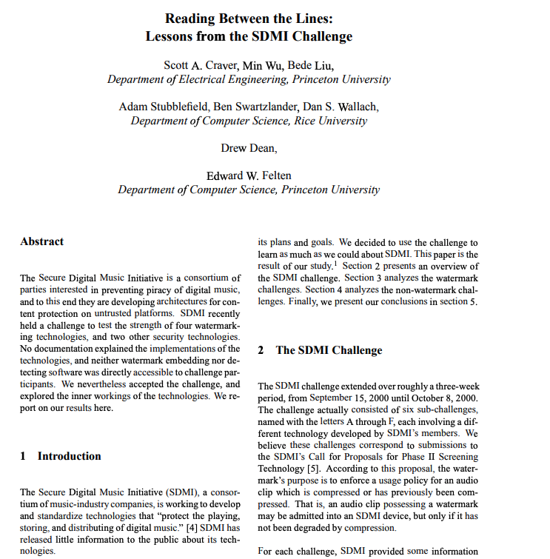
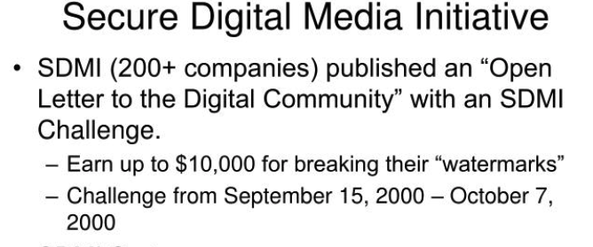
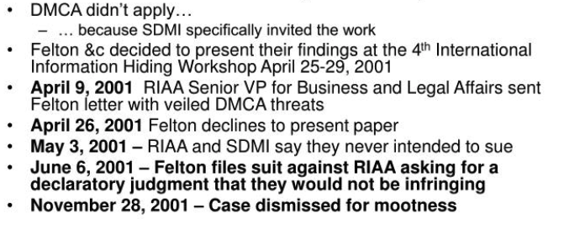

Slide 37
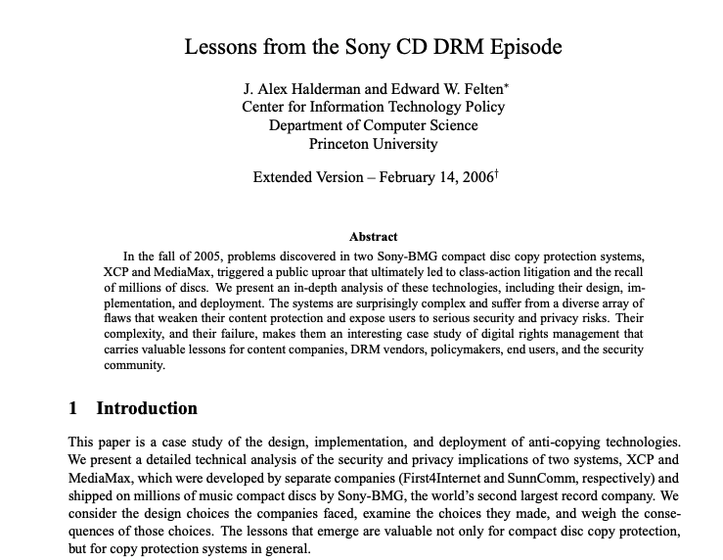

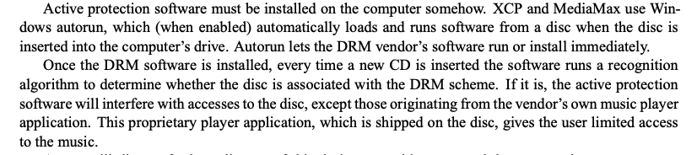

Slide 38
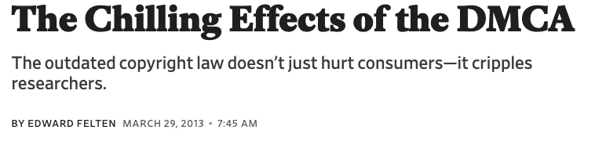
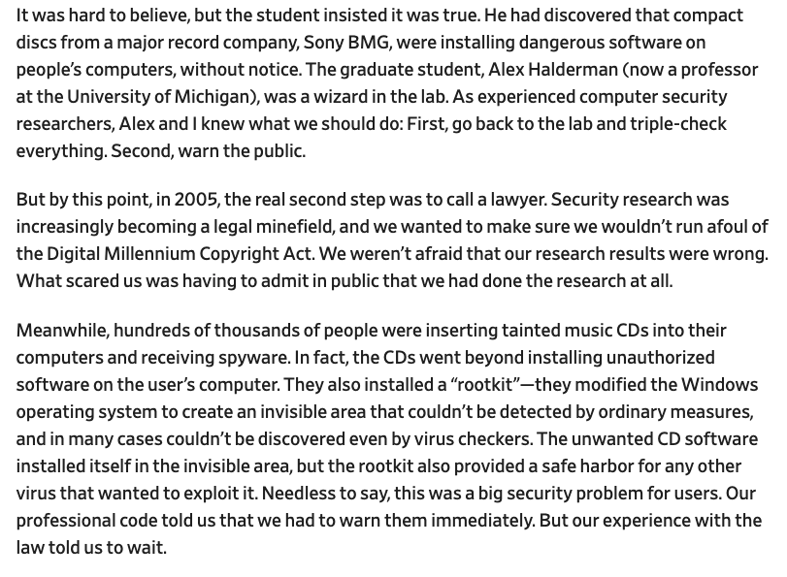
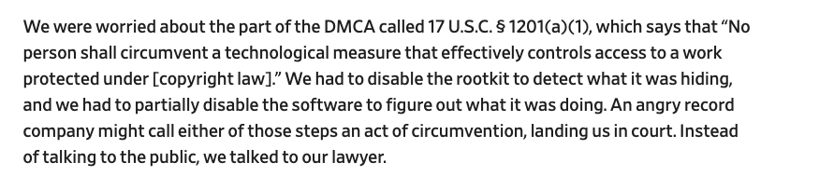
Security Research and the DMCA

Slide 39
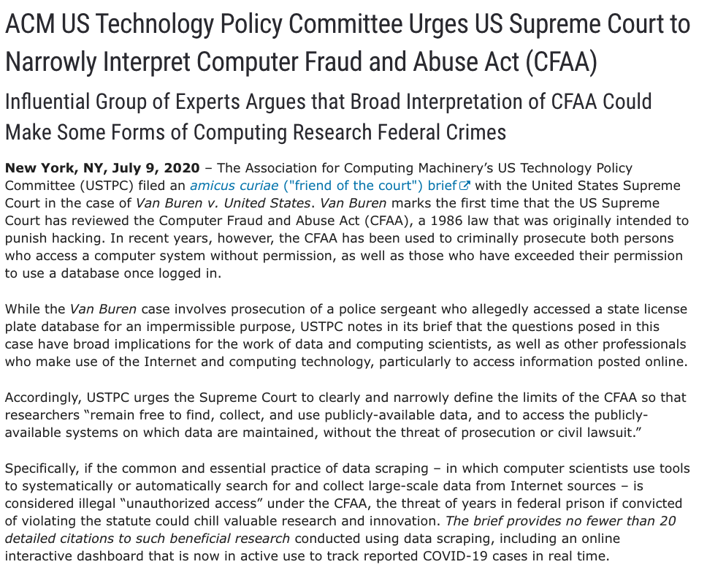
Internet “Scraping” and the CFAA

Slide 40
Contracts and Policies
End User License Agreements (EULA)
Do not criticize this product publicly
Using this product means you will be monitored
Do not reverse-engineer this product
We are not responsible if this product messes up your computer
Organizational Policies
Notes:
https://www.eff.org/pages/grey-hat-guide

Slide 41
Professional Ethical Codes
IEEE Code of Ethics (2006)
commits members “to the highest ethical and professional conduct”. Members agree to avoid conflicts of interest, be honest, engage in responsible decision making, accept criticism of work, etc.
ACM Code of Ethics and Professional conduct (1992)
“contribute to society and human well-being”, “avoid harm to others”, along with six other principles (e.g., don’t discriminate, be honest, respect privacy).

Slide 42
Breakout Sessions
Discuss the scenario in terms of the four principles from the Belmont/Menlo reports
What conclusions do you draw (if any)?
Would you have launched these experiments? Modified them in any way?

Slide 43
(Other) Existing Ethics Standards
1947 Nuremberg Code
Helsinki Declaration 1964
The IEEE, ACM, etc: Codes of Ethics
The Belmont Report, the National Research Act, and Institutional Review Boards (IRB)
45 CFR 46
“Rules of Engagement”
The Law of Armed Conflict
Dittrich/Himma: Active Response Continuum
Other Organizational Codes (Universities, Corporations, etc.)

